Slide 1
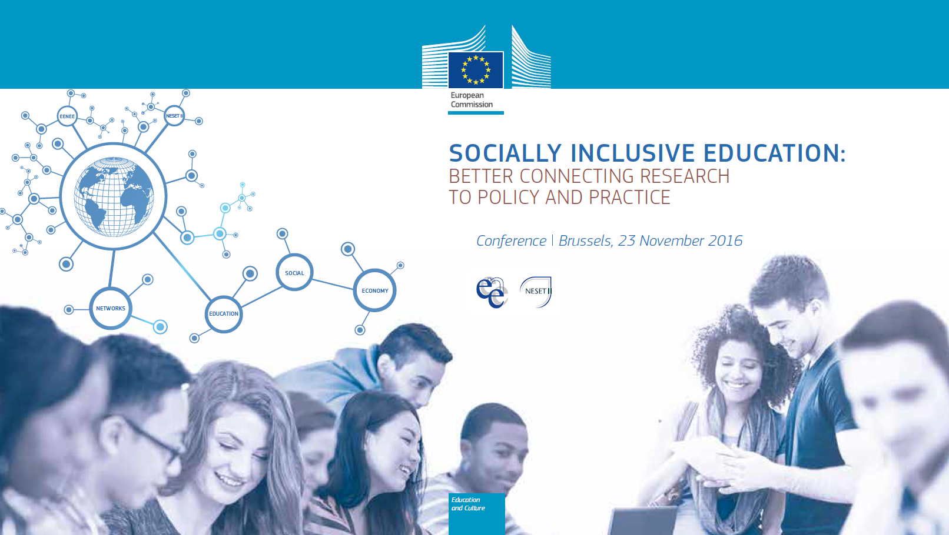

Slide 2
Socially inclusive education: better connecting research to policy and practice
from the early years on
Prof. Michel Vandenbroeck
Department of Social Work and Social Pedagogy
Ghent University, Belgium

Slide 3
New emerging challenges
Super-diversity

Slide 4
New emerging challenges
Super-diversity
e.g. 50% of BXL is multilingual > 100 languages
“(…) a dynamic interplay
of variables among an
increased number of small
and scattered,
multiple-origin,
transnationally connected,
socio-economically differentiated
and legally stratified populations”
(Vertovec, 2007)

Slide 5
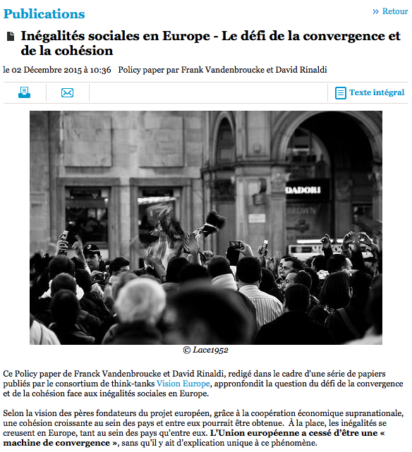
New emerging challenges
Super-diversity
EU stopped to be a converging machine
Vandenbroucke & Rinaldi 2015 for Institut Jacques Delors

Slide 6
New emerging challenges
Super-diversity
EU stopped to be a converging machine
Educational gaps may widen

Slide 7
Impact of ECEC:
on compulsory school;
on employment;
on parenting; and
on communities.
How does science relate to policy & practice?
What about unequal take-up?

Slide 8
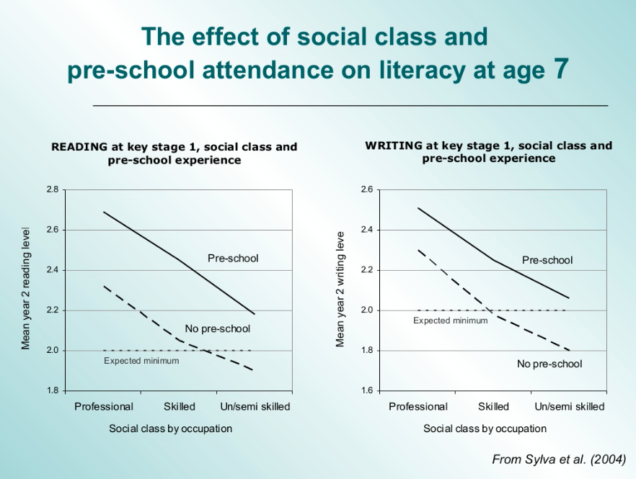
Impact of ECEC
on compulsory school
is well documented (e.g. EPPSE, CARE).

Slide 9
Impact of ECEC
on compulsory school and
on employment
is well documented (e.g. Van Lacker & Ghysels, 2016).

Slide 10
Impact of ECEC:
on compulsory school;
on employment;
on parenting; and
on communities.
Young families are mobile and live in diverse neighbourhoods.
Young families describe themselves as lonely and tired,
but
social support is a more salient form of parent support.

Slide 11
Impact of ECEC:
on compulsory school;
on employment;
on parenting; and
on communities.
Young families are mobile and live in diverse neighbourhoods.
Young families describe themselves as lonely and tired,
but
social support is a more salient form of parent support,
and
research has focused solely on teacher-parent relations.

Slide 12
Impact of ECEC:
on compulsory school;
on employment;
on parenting; and
on communities.
Young families are mobile and live in diverse neighbourhoods.
Young families describe themselves as lonely and tired,
but
social support is a more salient form of parent support.
New emerging services in EU and beyond:
meeting places;
education as a meeting place for bridging AND bonding?

Slide 13
Impact of ECEC:
on compulsory school;
on employment;
on parenting; and
on communities.
We now know about the potential of ECEC,
but what about unequal take-up?

Slide 14
Unequal across countries.
© Van Lancker & Ghysels

Slide 15
Unequal within countries.
© Van Lancker & Ghysels

Slide 16
Why?
1. First wave studies: it is the parents.
2. Second wave studies: environmental constraints; 3P.

Slide 17
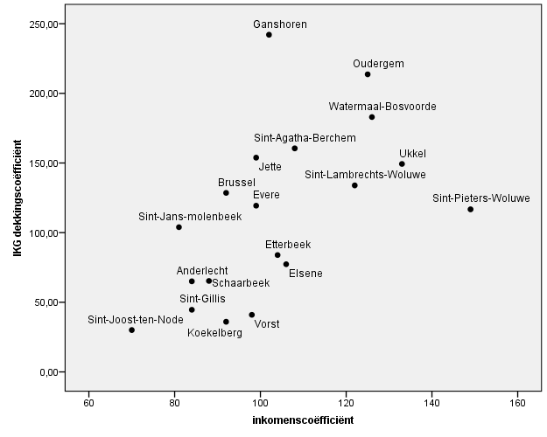
Why?
1. First wave studies: it is the parents.
2. Second wave studies: environmental constraints; 3P.
Policies:
Unequal distribution;
Funding parents is less efficient than funding provision;
Markets are not very efficient;
Debate on universal vs targeted is over; and
Progressive (proportionate) universalism.

Slide 18
Why?
1. First wave studies: it is the parents.
2. Second wave studies: environmental constraints; 3P.
Policies
Provision:
First come first served?
Other barriers: (language, conventions, …).

Slide 19
Why?
1. First wave studies: it is the parents.
2. Second wave studies: environmental constraints; 3P.
Policies
Provision
Parents:
Work arrangements;
Search processes;
Limited resources; and
Cultural barriers.

Slide 20
Why?
1. First wave studies: it is the parents.
2. Second wave studies: environmental constraints; 3P.
3. Third wave research: deliberate non take-up.
There is an increase of deliberate non-take-up in areas where affordability, availability and accessibility are secured.
What about desirability and usability?
Integration of functions: holistic vision.
Education and care;
Education and parents‘ support; and
Material and immaterial needs.

Slide 21
Conclusion:
It starts early and
educational services matter.
But, not all services matter equally.

Slide 22
We need to know more about the voices of different groups of parents to understand deliberate non-take-up;
We need to invest in professionalisation of staff to work in contexts of super-diversity;
We need to look at smooth transitions;
We need to balance care and learning; and
We need to balance material and immaterial needs.
And finally…

Slide 23
There are only a limited number of places where social inclusion and social cohesion can be fostered.
If we do not fully invest in these, we may lose the game.
Michel.Vandenbroeck@UGent.be

