Slide 1
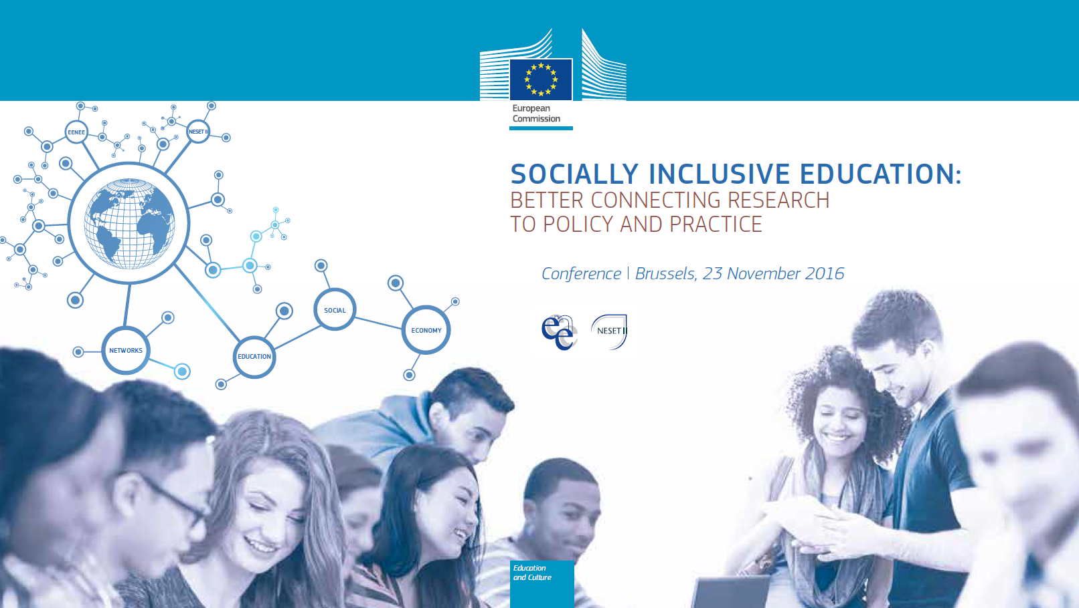

Slide 2
NNESESET II Report Main Findings
NESET II REPORT MAIN FINDINGS
Barry van Driel International Association for Intercultural Education
Brussels, Nov 23 2016

Slide 3
Research: An era of uncertainty, lack of belonging, growing nationalism and intolerance.
Attitude surveys and elections across the EU show a shift towards nationalism, intolerance and support for far right ideas and parties;
This is also reflected among young people;
Lack of sense of belonging among many migrants – poses a challenge for the next decades and beyond;
Widespread misinformation among young people about each other, especially about minorities and their respective cultures and religions;
Schools unprepared for diversity; and
‘Trump effect’.

Slide 4
The evidence: Schools, teachers and teacher education
Too few schools with explicit diversity or equality ethos (approx. 1/3);
Lack of personal experience;
Lack of sufficient training in the development of intercultural competences and in how to discuss controversial issues;
Teachers indicate they lack such training;
Biases: mostly subtle in nature; and
Lack of diversity among teachers.

Slide 5
The research conclusions: What tends to work?
Strong school ethos supported by stakeholders;
Whole-school approach and strong ties to community (e.g. Service Learning);
Ability to create safe spaces;
Teaching about controversial issues in the classroom;
Prioritising behaviour-intervention over attitude-intervention.
Project based learning (also new media); cooperative learning;
Mixing students, but according to ‘contact theory’;
History education that connects, not divides, and is more inclusive; and
Student involvement, peer education, and peer mediation.

Slide 6
Thank you!
Barry van Driel
barry@iaie.org

