Slide 1
Group session 3: Inclusion of learners with special educational needs (SEN) in mainstream education

Slide 2
Higher Education and Disability:
PREMISE, PROMISE, and PRACTICE
Arthur Limbach-Reich
Notes:
Inklusions Smarties ( Kastl 2012): Jörg Michael Kastl: (2012) Inklusion und Integration - oder: Ist „Inklusion“ Menschenrecht oder eine pädagogische Ideologie? Soziologische Thesen. Vortrag in der Villa Donnersmarck, Berlin am 16.10.2012 Friedrichshainer Kolloquien 2012(Institut Mensch, Ethik und Wissenschaft / Fürst-Donnersmarck-Stiftung zu Berlin)
Prengel, Annedore. (2003): Pädagogik der Vielfalt. Verschiedenheit und Gleichberechtigung in Interkultureller, Feministischer und Integrativer Pädagogik. Opladen: Leske+ Budrich
Picture downloaded: 02 November 2016 at http://oureverydaylife.com/types-inclusion-schools-20175.html
Limbach-Reich & Powell 2016

Slide 3
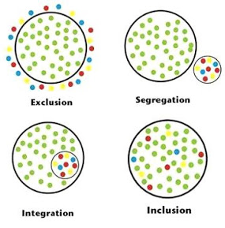
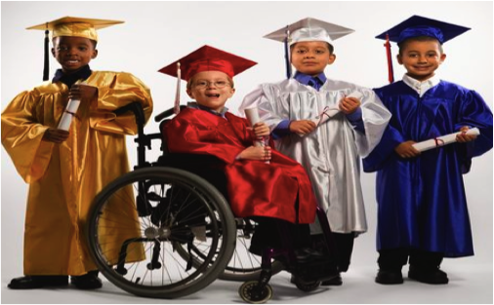
PREMISE, PROMISE, and PRACTICE
Egalitäre Differenz
http://everydaylife.globalpost.com/types-inclusion-schools-20175.html
(non)- accessibility and (missing) reasonable accommodations
CRPD (2006) Inclusive education, full inclusion
Higher Education for All
Notes:
Inklusions Smarties ( Kastl 2012): Jörg Michael Kastl: (2012) Inklusion und Integration - oder: Ist „Inklusion“ Menschenrecht oder eine pädagogische Ideologie? Soziologische Thesen. Vortrag in der Villa Donnersmarck, Berlin am 16.10.2012 Friedrichshainer Kolloquien 2012(Institut Mensch, Ethik und Wissenschaft / Fürst-Donnersmarck-Stiftung zu Berlin)
Prengel, Annedore. (2003): Pädagogik der Vielfalt. Verschiedenheit und Gleichberechtigung in Interkultureller, Feministischer und Integrativer Pädagogik. Opladen: Leske+ Budrich
Picture downloaded: 02 November 2016 at http://oureverydaylife.com/types-inclusion-schools-20175.html
Limbach-Reich & Powell 2016

Slide 4
Inclusion: → Full Inclusion
all students in the mainstream regular education and regular classes with appropriate educational programs
support and assistance
everyone belongs,
is accepted &
supported
having his or her educational needs met
?
School University
Source: Stainback, S. B., & Stainback, W. C. (1990, 3).
Notes:
Stainback, S. B., & Stainback, W. C. (1990). Inclusive schooling. In W. C. Stainback & S. B. Stainback (Eds.), Support networks for inclusive schooling: Interdependent integrated education (p. 3–23). Baltimore, MD: Brookes: „An inclusive school is one that educates all students in the mainstream. Educating all students in the mainstream means that every students is in regular education and regular classes (...). It also means providing all students within the mainstream appropriate educational programs that are challenging yet geared to their capabilities and needs as well as any support and assistance they and/or their teachers may need to be successful in the mainstream. But an inclusive school also goes beyond this. An inclusive school is a place where everyone belongs, is accepted, supports, and is supported by his or her peers and other members of the school community in the course of having his or her educational needs met.“ (S. 3).

Slide 5
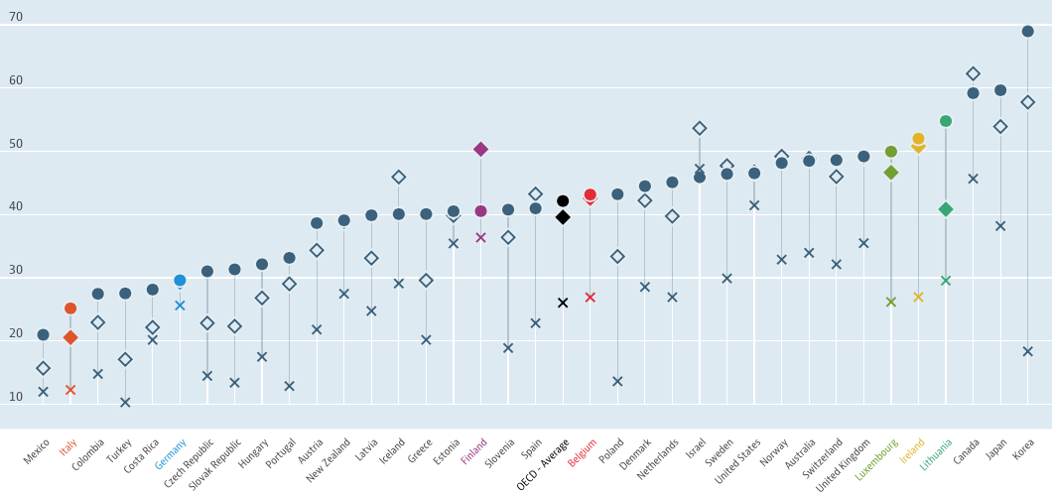
HE = HE ?
for all ?
Population with tertiary education
% in same age group, 2015
OECD (2016) Education at a Glance
Notes:
The ranking of the percentage on tertiary education doesn’t reflect national inclusion policy in education: In Italy with is longstanding and extensive fare reaching inclusion policy less persons attain a tertiary education level than in Luxembourg with a traditional special education system.
In Finland it seems that recently less persons attain a university degree than ten years before.

Slide 6
Inclusion in Higher Education (selected Countries)
Are German universities more inclusive than French or Italian universities?
Country | (Increase of) enrolment of students with disabilities
Germany | 2003 to 2006 from 15 % to 18.5 % ; 14 % in 2012
France | 2000 to 2006 from 0.2 % to 0.4 %; 1 % in 2013
Italy | 0.9 % in 2013
Source: OECD, (2008) and OECD, (2011); DSW (2013)
Italy: Maggiolini & Molteni (2013, p. 251).
Notes:
Are German Universities more inclusive than French or Italian?

Slide 7
Reasons to waive r.a. | Percentage
Don’t know the option | 57
Don’t want to be treated special | 44
Don’t believe of being eligible | 43
Too shy to ask staff | 37
Discretion preference | 33
Too shy to go to the concerned office | 32
Don’t know for sure whether being eligible | 31
Don’t know anybody to ask for counseling or assistance | 26
Too much additional work | 16
Measure not helpful | 14
Need already previously unconsidered | 4
Request already previously rejected | 1
Why students waive reasonable accommo-dations?
(in Germany)
Source: DSW data: Unger et al., 2012, p. 191.
Notes:
Unger, M.; Wejwar, P.; Zaussinger, S.; Laimer, A., Beeinträchtigt studieren. Datenerhebung zur Situation Studierender mit Behinderung und chronischer Krankheit 2011, Paper presented at the conference 'Es ist normal verschieden zu sein. Wunsch oder Wirklichkeit? Studieren mit Behinderung/chronischer Krankheit an deutschen Hochschulen im Jahr 2012', 2012.

Slide 8
What helps?
Support received | cognit. dis. | psych. dis | learn. dis | moto. dis | health dis. | visual. dis. | hear. dis. | multi. dis | total
Human support (p=0.002) | 18.9 % | 7.5 % | 19.5 % | 14.9 % | 6.4 % | 14.7 % | 7.4 % | 3.8 % | 14.5 %
Technical support (p=0.0027) | 10.8 % | 11.3 % | 16.5 % | 18% | 6.4 % | 17.6 % |  | 3.8 % | 13.8 %
Teaching support (p<0.0001) | 40.5 % | 26.4 % | 42.8 % | 36.6 % | 20.4 % | 47.0 % | 3.7 % | 26.9 % | 35.1 %
No need (p<0.0001) | 16.2 % | 22.6 % | 25.9 % | 26.0 % | 47.3 % | 11.7 % | 37.0 % | 11.5 % | 27.2 %
Success factors
Teaching method (p=0.002) | 32.3 % | 31.3 % | 29.4 % | 34.3 % | 9.2 % | 10.0 % | 10.0 % | 14.3 % | 28.1 %
Family support (p=0.006) | 56.3 % | 63.2 % | 61.5 % | 57.9 % | 39.5 % | 46.2 % | 46.2 % | 63.2 % | 56.8 %
Assessment of progress (p=0.006) | 10.0 % | 13.8 % | 15.3 % | 20.5 % | 7.8 % | 38.5 % | 38.5 % | 7.1 % | 15.2 %
Source: OECD 2011 in Ebersold, S., Transitions to Tertiary Education and Work for Youth with Disabilities, Education and Training Policy, Paris: OECD

Slide 9
t
tion
k
o
for
o
Thang yur 4 yur adtenshen

