Slide 1
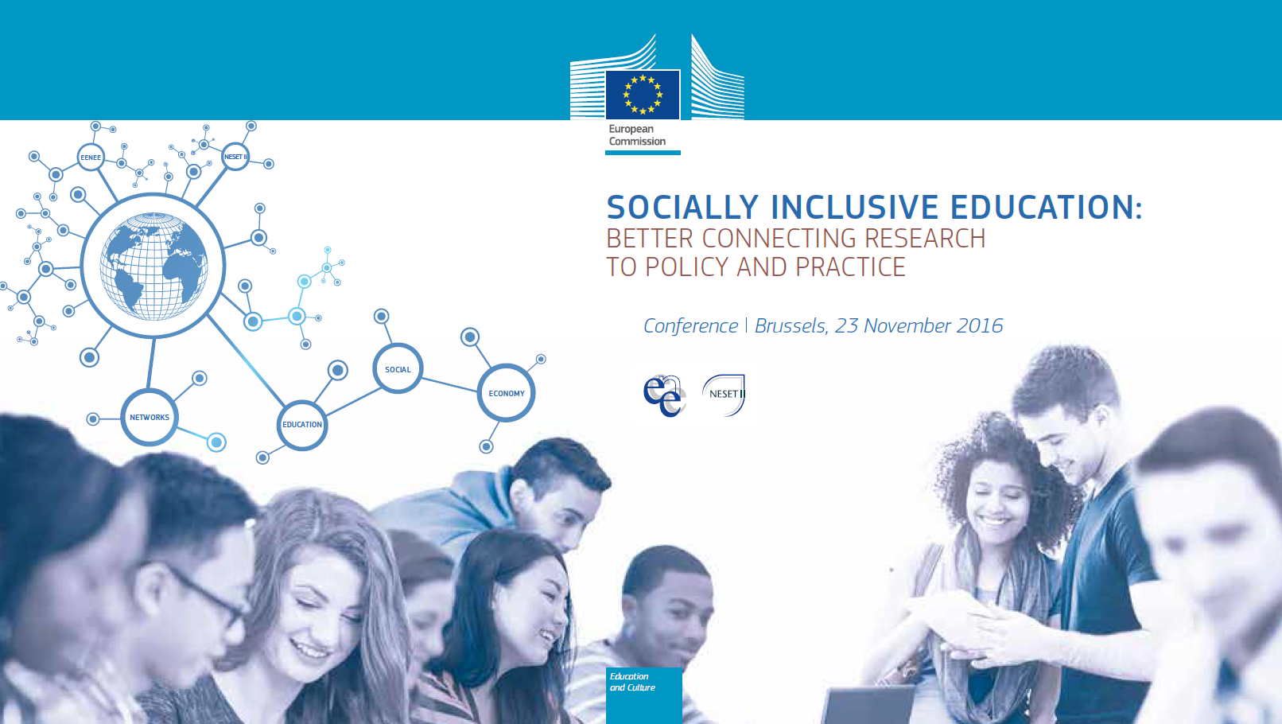
Notes:
Ladies and Gentlemen, I want to welcome you to our workshop and particularly to my presentation

Slide 2
Integration of Migrants and Refugees through Education
Examples of Good Practices
Dr. Barbara Herzog-Punzenberger
Dpt of Education, Head of Unit « Migration and Education »
Johannes Kepler University Linz
Notes:
Which will be devoted to the question of integration of migrants and refugees through education

Slide 3
Levels of Integration in Education
SUPRA international (e.g. European Union)
MACRO national (country, educational policies)
MESO organizational unit in formal education (school)
MICRO classroom (interactional unit concerning teaching and learning)
NANO individual (pupil + family background)
Notes:
Obviously, integration and education are very complex processes, each in its own right and more so in combination, i.e. mutual interaction. In our short presentations we can not treat all the levels and to avoid being too superficial we concentrate on specific aspects. To give you a framework for orientation which levels we are targeting in our presentation I propose this schema where we categorize five levels of integration in education which by implication are interdependent. While Prof. Brunello has elaborated on structural questions such as school stratficiation and early tracking which is also strongly connected to segregation and family background my presentation will focus ...

Slide 4
Most important findings concerning structural issues (1)
Age of first participation in educational institutions: the earlier the better (from age 2 onwards proven in longitudinal studies e.g. EPPSE)
Quality of Early Childhood Education and Care
(cognitive and socio-emotional advantage from high quality ECEC until adulthood e.g. EPPSE)
Age of first selection in the school-system
(the later the better)
Duration of schooling per day
(the longer the better, but no long-term effect from pre-primary)

Slide 5
Most important findings concerning structural issues (2)
Grade repetition does not yield any additional value
Socio-economic reproduction differs and can be moderated
No relation between share of immigrant pupils on the national level and average academic output of a country (e.g. results from large scale assessments such as PISA, TIMSS, PIRLS)
Segregation in neighbourhood, schools and classrooms impacts academic results and can be moderated

Slide 6
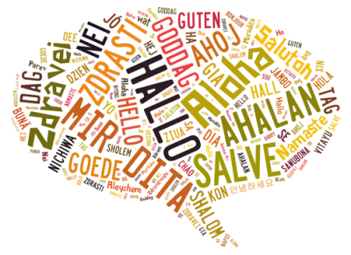
Levels of Integration in Education
SUPRA international (e.g. European Union)
MACRO national (country, educational policies)
MESO organizational unit in formal education (school)
MICRO class (interactional unit concerning teaching and learning)
NANO
individual (pupil + family background)
>>> language acquisition in a multilingual school environment
Notes:
…on the nano level of language acquisition and development in multilingual environments

Slide 7
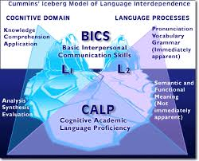
Language acquisition in a multilingual environment – basic knowledge
1.) The cognitive academic language proficiency CALP differs from
basic interpersonal communication skills BICS
2.) To catch up in CALP in a second language needs up to 6 years and depends on instructional provisions, support structures and individual predispositions
Notes:
Some of the insights might not be new to you, others have been around only in very restricted circles such as linguists. The point however is that only when understanding the specific nature of language acquisition and development support structures can adapt adequately. It is important to acknowledge that the development of the academic register (CALP cognitive academic language proficiency) of another language takes up to six years (and for a third of the pupils even longer). CALP is a register of any language which is usually not used in oral conversation, i.e. at home in families. However, the language that is used in families where parents have high educational credentials is usually closer to the academic register (of any ‚generic‘ language) than conversational language in families where parents have not attended school or for a shorter period of time. As you can see in the graphic on the right hand side the percentage of pupils who reached or exceeded the provincial reading standards in Ontario, Canada disaggreagted by length of stay (Coelho 2012)

Slide 8
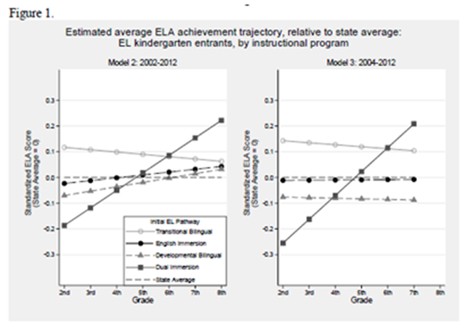
3.) Fully bilingual (dual immersion) programms yield higher results, e.g. in language proficiency than all other instructional programs
the development of family language does not harm the development of school language
The academic advantage only becomes visible after six years of dual immersion
Valentino & Reardon 2014, data from schools in California
Notes:
Also in math pupils from dual immersion programs have same or better results than those from other instructional programs. Important however is that the advantage only gets visible after six years of schooling in dual immersion.

Slide 9
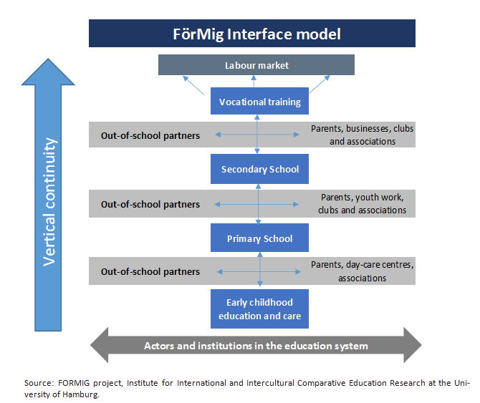
Three-dimensional continuity of language education: biographic, thematic, multilingual
Notes:
Proceeding one level up the educational system has to respond to the fact that language education works best in a continuum. The German research-group around Prof. Gogolin, Prof. Neumann and others have developed in a large tranfer project in six federal-states the concept of Continous Language Education (Durchgängige Sprachförderung) which encompasses biographical continuity (vertical and horizontal), thematic continuity, multilingual continuity.

Slide 10
Selected good pratices
Parental involvement
Mentoring (child-centered)
Material
Curriculum
Support structures for schools
Notes:
Obviously, integration and education are very complex processes, each in its own right and more so in combination, i.e. mutual interaction. In our short presentations we can not treat all the levels and to avoid being too superficial we concentrate on specific aspects. To give you a framework for orientation which levels we are targeting in our presentation I propose this schema where we categorize five levels of integration in education which by implication are interdependent. While Prof. Brunello has elaborated on structural questions such as school stratficiation and early tracking which is also strongly connected to segregation and family background my presentation will focus ...

Slide 11
Support parental involvement
Information on plurilingualism for migrant parents (Norway)
Family literacy project (Switzerland)
HIPPY Home Instruction for Parents and Pre-school Youngsters (Israel, USA, NL, FRG, CH, AT,…)
Migrant Parents Networks MEN (Lower Saxony)
Parent, Family, Community Engagement Framework (US Head Start P.)
Quality in Cooperation with Parents (A Guideline for ECEC, Germany)
Notes:
Obviously, integration and education are very complex processes, each in its own right and more so in combination, i.e. mutual interaction. In our short presentations we can not treat all the levels and to avoid being too superficial we concentrate on specific aspects. To give you a framework for orientation which levels we are targeting in our presentation I propose this schema where we categorize five levels of integration in education which by implication are interdependent. While Prof. Brunello has elaborated on structural questions such as school stratficiation and early tracking which is also strongly connected to segregation and family background my presentation will focus ...

Slide 12
Mentoring (child-centered)
Summer-camp (Sowieso mehr. Deutsch lernen mit Spiel, Sport und Spaß; half day language, half day sports; City of Vienna, very low fees)
Nightingale Mentoring (students support children with low SES background and migration background AT, ES, FRG, SE, SU, CH,…)
The Mentoring Handbook & European Network for Educational Support Projects
Notes:
Obviously, integration and education are very complex processes, each in its own right and more so in combination, i.e. mutual interaction. In our short presentations we can not treat all the levels and to avoid being too superficial we concentrate on specific aspects. To give you a framework for orientation which levels we are targeting in our presentation I propose this schema where we categorize five levels of integration in education which by implication are interdependent. While Prof. Brunello has elaborated on structural questions such as school stratficiation and early tracking which is also strongly connected to segregation and family background my presentation will focus ...

Slide 13
Material
Interfaith Wallchart-Calender
Journal from and for 2nd generation (e.g. biber in AT/Vienna)
PUMA (folding-poster for language-sensitive work in ECEC)
TRIO (trilingual journal for learning to read; stories constructed so that all three langugages are needed to answer questions)
The Media Initiative for Children Respecting Difference (Irland, ECEC & primary school, training for staff, parents and children, cartoons & dolls)
Notes:
Obviously, integration and education are very complex processes, each in its own right and more so in combination, i.e. mutual interaction. In our short presentations we can not treat all the levels and to avoid being too superficial we concentrate on specific aspects. To give you a framework for orientation which levels we are targeting in our presentation I propose this schema where we categorize five levels of integration in education which by implication are interdependent. While Prof. Brunello has elaborated on structural questions such as school stratficiation and early tracking which is also strongly connected to segregation and family background my presentation will focus ...

Slide 14
Curriculum
Culturally responsive curriculum
Multilingualism curriculum – Linguistically-sensitive subject-teaching
CONBAT Content Based Teaching + Plurilingual/Cultural Awareness (European Center for Modern Languages, Council of Europe)
Notes:
Obviously, integration and education are very complex processes, each in its own right and more so in combination, i.e. mutual interaction. In our short presentations we can not treat all the levels and to avoid being too superficial we concentrate on specific aspects. To give you a framework for orientation which levels we are targeting in our presentation I propose this schema where we categorize five levels of integration in education which by implication are interdependent. While Prof. Brunello has elaborated on structural questions such as school stratficiation and early tracking which is also strongly connected to segregation and family background my presentation will focus ...

Slide 15
Support structures for schools
Website « Schule mehrsprachig » (ministry offers all information on multilingualism legal, statistical, bibliographical, projects in schools,…)
VOXMI – network of schools which engage in mulitlingual schooling sustained by the ministry and local authorities
Federal Center for interculturality, migration and multilingualism BIMM
Resource center for teacher training institutions, teacher educators, networking
of responsible
4) QUIMS Quality in multicultural schools (Zurich, CH) obligatory for schools with 40%+ migrant pupils: additional budget, personal resources for coordination, training of teachers, work with parents
Notes:
Obviously, integration and education are very complex processes, each in its own right and more so in combination, i.e. mutual interaction. In our short presentations we can not treat all the levels and to avoid being too superficial we concentrate on specific aspects. To give you a framework for orientation which levels we are targeting in our presentation I propose this schema where we categorize five levels of integration in education which by implication are interdependent. While Prof. Brunello has elaborated on structural questions such as school stratficiation and early tracking which is also strongly connected to segregation and family background my presentation will focus ...

Slide 16
Teacher competences and training
Sprachkopf (Germany): Test for teachers concerning their language competences, i.e. knowledge and skills, diagnose gaps and provaid training
Heidelberger Interaktionstraining für pädagogisches Fachpersonal to support mono- and multilingual children => language use of personal is crucial!
training has to be directed towards everyday interaction, it has to last minimum 6 days over at least six months with regular meetings to discuss implementation
3) DaZKom – competence model for teachers in grade 5-8 to learn language-sensitive subject teaching
Intercultural opening up of schools (Hamburg, Germany): (1) awareness-raising and self-reflection concerning bias and stereotypes, (2) intercultural whole-school development, (3) change management
ECML European Framework for Content and Language integrated learning CLIL
Notes:
Obviously, integration and education are very complex processes, each in its own right and more so in combination, i.e. mutual interaction. In our short presentations we can not treat all the levels and to avoid being too superficial we concentrate on specific aspects. To give you a framework for orientation which levels we are targeting in our presentation I propose this schema where we categorize five levels of integration in education which by implication are interdependent. While Prof. Brunello has elaborated on structural questions such as school stratficiation and early tracking which is also strongly connected to segregation and family background my presentation will focus ...

Slide 17



…finally
teacher-education and training
leadership in whole-school development
AND system-wide commitment are the key!

Slide 18
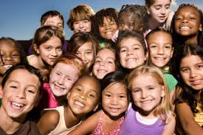
Thank for attention!
You your

