Slide 1
Strengthening social and emotional education as a core curricular area across the EU Carmel Cefai, Paul Bartolo, Valeria Cavioni, Paul Downes
NESET II and EENEE Conference
Brussels, 22 November 2018

Slide 2
Objectives
to evaluate the effectiveness of SEE in terms of social, emotional and academic outcomes
to identify the conditions for effectiveness
to develop a framework for a more effective integration of SEE in curricula across the EU

Slide 3
Methodology
Review of international research, including in-depth analysis of 13 major reviews, additional reviews, studies, and research reports, amongst them several from Europe (screened for quality and reliability)
Report focused on studies, particularly reviews of studies, of universal school-based SEL or directly related areas (eg. classroom management), but excluded targeted interventions, evaluations of health promotion, citizenship
Notes:
Papers were screened for whether they provided adequate information on their methodology (quality and reliable studies)
eg. information on its data search, its general inclusion and exclusion criteria, type of studies selected (RCT/quasi exp), effect sizes)

Slide 4
Impact
Increase in SE competences
Increase in prosocial attitudes and behavior
Increase in academic learning
Decrease in negative behaviours: anti-social behavior, delinquency, anxiety and depression
Modest effect sizes (0.22 to 0.57) but comparable/ higher than those of other psychosocial interventions
Effective across school years, especially in early years, and across geographical setting (urban/rural), SES or ethnicity
Effects maintained from 6 mths to 3 years
Notes:
Sklad eg al (2013) Largest immediate effects: reduction in anti-social behaviour and enhanced social-emotional skills; in the long-term, greatest impact in enhanced academic achievement and reduced substance misuse.

Slide 5
A framework
for effectiveness
Notes:
10 components

Slide 6
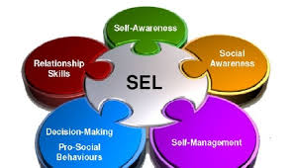
Need for a balanced curriculum, focusing on both interpersonal and intrapersonal domains
Quality Implementation
Citizenship, health promotion, physical education, prevention of violence and bullying, moral/religious education, overlap but do not substitute SEE
Targeted
interventions
Curriculum
Staff
competence
& wellbeing
Intra- and inter-personal competences
Climate
Parental
engagement &
education
Early
Intervention
Student
Voice
Quality Adaptation
Notes:
balance

Slide 7
SEE must be structured and integrated in the curriculum, not add on (SAFE) - Need for increased time on the timetable on SEE as a core content area of the curriculum
SEE is recognized as a key aspect of education in MS, but there is not yet sufficient common focus on SEE as a core curricular area
Quality Implementation
Targeted
interventions
Curriculum
Staff
competence
& wellbeing
Intra- and inter-personal competences
Climate
Parental
engagement &
education
Early
Intervention
Student
Voice
Quality Adaptation
Notes:
Structured, in the timetable, teacher training, part of the mainstream curriculum

Slide 8
SEE needs also to be ‘caught’ through relational, contextual supports
Teachers need professional development to improve their own relational and cultural competences -communication, empathy, conflict management (eg. discriminatory bullying, authoritarian teaching)
Quality Implementation
Targeted
interventions
Curriculum
Staff
competence
& wellbeing
Intra- and inter-personal competences
Climate
Parental
engagement &
education
Early
Intervention
Student
Voice
Quality Adaptation

Slide 9
We need to start early -early SEE is related to happy and productive adults (Jones et al, 2015)
SEE offers strong economic and financial returns on investment (Belfield et al, 2015)
Quality Implementation
Targeted
interventions
Curriculum
Staff
competence
& wellbeing
Intra- and inter-personal competences
Climate
Parental
engagement &
education
Early
Intervention
Student
Voice
Quality Adaptation

Slide 10
Need for active child voice in learning and active participation in design and production of SEE material
Quality Implementation
Targeted
interventions
Curriculum
Staff
competence
& wellbeing
Intra- and inter-personal competences
Climate
Parental
engagement &
education
Early
Intervention
Student
Voice
Quality Adaptation

Slide 11
SEE is also about adults: parents’ active engagement- equal partners, not top down
Quality Implementation
Targeted
interventions
Curriculum
Staff
competence
& wellbeing
Intra- and inter-personal competences
Climate
Parental
engagement &
education
Early
Intervention
Student
Voice
Quality Adaptation

Slide 12
SEE is also about teachers’: education and own wellbeing
SEE leads to more competent, more confident, more satisfied teachers
Quality Implementation
Targeted
interventions
Curriculum
Staff
competence
& wellbeing
Intra- and inter-personal competences
Climate
Parental
engagement &
education
Early
Intervention
Student
Voice
Quality Adaptation

Slide 13
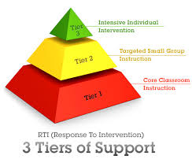
Children with additional SE needs need extra support
Quality Implementation
Targeted
interventions
Curriculum
Staff
competence
& wellbeing
Intra- and inter-personal competences
Climate
Parental
engagement &
education
Early
Intervention
Student
Voice
Quality Adaptation

Slide 14
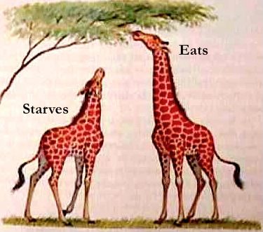
Quality implementation key to effectiveness (adequate planning, coordination, monitoring, evaluation)
Need for sensitivity and adaptation to context: balance between fidelity and adaptation
Quality Implementation
Targeted
interventions
Curriculum
Staff
competence
& wellbeing
Intra- and inter-personal competences
Climate
Parental
engagement &
education
Early
Intervention
Student
Voice
Quality Adaptation

Slide 15
Quality Implementation
Targeted
interventions
Curriculum
A whole school approach to SEE
Staff
competence
& wellbeing
Intra- and inter-personal competences
Climate
Parental
engagement &
education
Early
Intervention
Student
Voice
Quality Adaptation
Notes:
10 components

Slide 16
THANKS
carmel.cefai@um.edu.mt
Background document: NESET II AR3/2017

