Slide 1
Education Outcomes Enhanced by the Use of Digital Technology:
Gráinne Conole
NESET II and EENEE Conference
Brussels, 22 November 2018

Slide 2
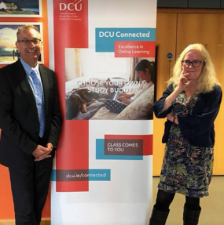
Research questions
Education outcomes enhanced by the use of digital technologies: reimaging the new learning ecology
  How does digital technology enhanced teaching and learning?
  What are the enablers for successful digital technology use?
  What are the implications for policy and transformative curriculum reforms?
With Mark Brown and Miroslav Beblavy

Slide 3

Outline
Foregrounding literature
Theoretical lens
Changing nature of the digital society
Affordances of digital technology
Effective pedagogy for innovation
Continuous Professional Learning
Barriers
Principles and recommendations
Final reflections

Slide 4
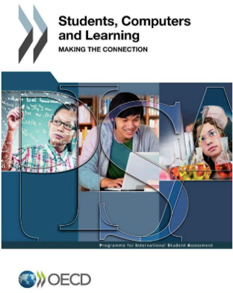
OECD seminal report
ICT has revolutionised virtually every aspect of our life and work
Students
  Unable to navigate through a complex digital landscape will no longer be able to participate fully in the economic, social and cultural life around them
  Students as critical consumers of Internet services and electronic media and make informed choices
Challenges
  Information overload, plagiarism, online risks

Slide 5

Real transformation?
Study of 41 classrooms
Questions whether digital technology has transformed teaching and learning
More incremental change and cross-pollination than top-down policy mandates

Slide 6
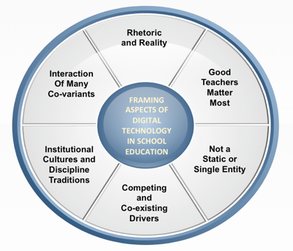
Theoretical lens
Potential to enhance and transform
Quality and effectiveness of pedagogy and outcomes depend on teachers
New technologies arising all the time
Limited change or progress
Traditional modes of instruction and assessment dominate
Many factors mediate success

Slide 7
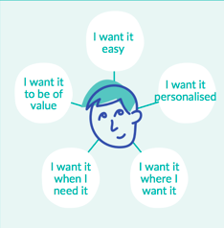
Nature of today’s digital society
Changing nature of work
  65% of jobs of the future don’t exist now
  From knowledge recall to critical thinking…
Millennial generation
  Different needs and expectations
  IWWIWWIWI
  Development of academic literacy skills
  Adaptive and lifelong learners
  Mixed of formal and OER/MOOCs
  New forms of accreditation
  Changing role of teachers and learners

Slide 8
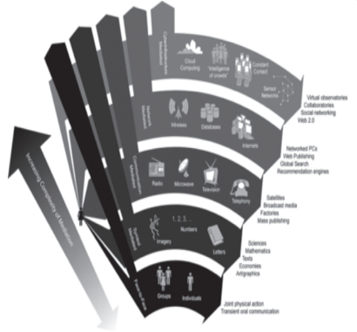
Affordances
Phases:
  Cultural, symbolic, communication, networked, cyber-infrastructure
Affordances
  Differ according to the technology, context and use
  Internet most disruptive technology of last 50 years

Slide 9

Opportunities
Technologies can:
  enable more interaction & communication;
  help with retention;
  be engaging & motivational;
  extend the classroom;
  provide timely and targeted feedback;
  personalise the learning experience;
  BUT: technology is not a single entity; no single all-encompassing answer can be provided to the question of impact on educational outcomes.

Slide 10
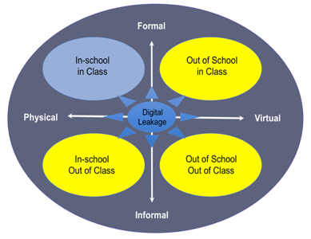
Digital leakage
Classroom expanded and evolved as virtual place sits alongside physical
A variety of different complementary learning opportunities
Further evidence of blurring of boundaries
Brown, 2015

Slide 11
Teacher-centred | Learning-centred
Learning of facts and declarative knowledge Memorising information Teacher is central A focus on passing exams Drilling of right questions and routines Learning to pass exams Focus on information presentation to passive learning Technology as a media channel Learning from resources and technology | Learning of conceptual knowledge Working with information Activity is central to learning Applying knowledge, theoretical thinking and demonstrating generic skills Problem-solving, design, project work and inquiries Learning how to learn Focus on how learning occurs within an activity Technology as intellectual partner in learning Learning with resources and technology
Churchill (2017)
Sfard (1998): acquisition vs. participation

Slide 12
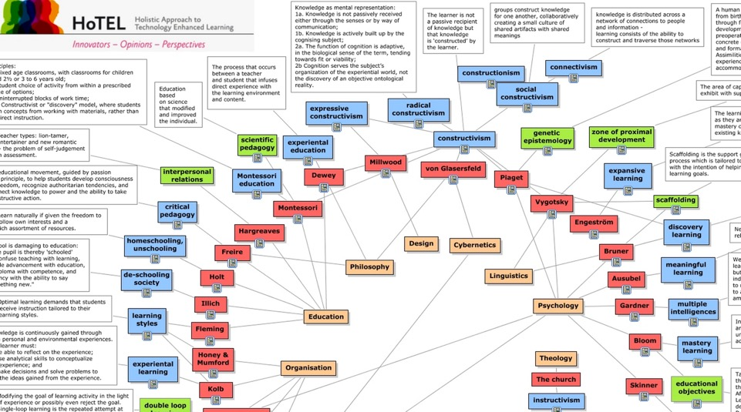

Slide 13
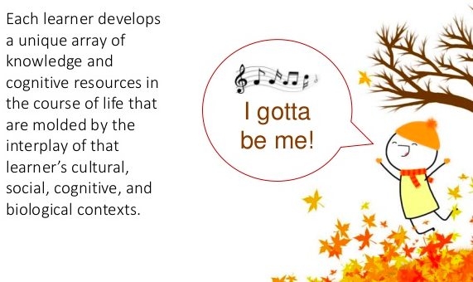
Effective instruction depends on understanding of the complex interplay among learners’ prior knowledge, experiences, motivations, interests, and language and cognitive skills; educators’ own experiences and cultural influences; and the cultural, social, cognitive, and emotional characteristics of the learning environment
(National Academy of Sciences, 2018)

Slide 14
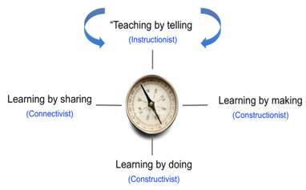
A pedagogical compass
UNESCO Pillars of learning
  Learning to be, do, know, live together
‘Pedagogical compass’
  Needs to swing between all four
  Needle is not always pointing towards more traditional ‘learning by listening’
  Should not be stuck in any particular direction, as effective pedagogy requires a variety or combination of approaches
Brown, 2018

Slide 15

Constraints and conflicts
First order: constraints & limitations external to teachers
  Funding and resource
  Infrastructure
  Access and time
  Leadership
Second order: conflicts & tensions internal to teachers
  Teacher confidence
  Teacher beliefs and attitudes
  Resistance to change
  Reluctance to adopt new technologies

Slide 16

Teacher focussed
Continuing Professional Learning
  Central role of the teacher
  Enable teachers to develop innovative learning interventions
  Make effective use of digital technologies
Formats
  Specialised and tailored workshops
  Peer support and mentoring
  Examples of good practice
  Share and discuss practice
  Resources, OER and MOOCs

Slide 17

Beware the rhetoric
65% of future jobs don’t exists – debunked
  Overly positivist accounts, not taking account of the nuances
  Lack of credibility, not build on empirical evidence
Millennial generation – discredited
Uncritical adoption of popular teaching and learning ‘catchisms’ – claims and counterclaims

Slide 18

Recommendations
Digital learning ecology is complex
  More research needed to understand the complexity
Influence of affordances
  Understand affordances & how they support pedagogy
No single metaphor for 21st Century learning
  Support for learning needs to match learner needs and the context of learning
Assessment needs to support deep learning
  Needs to be purposeful & support active, authentic and meaningful learning

Slide 19
Recommendations
Teachers’ mindsets mediate technology implementation
  Targeted and authentic CPL
Impact of leadership and institutional cultures
  Need to align with factors for successful update of digital technologies
Refocus and change mindsets
  From education in change to education for change

Slide 20
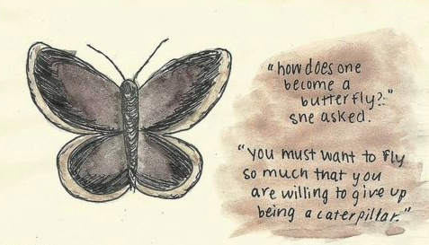
Change isn’t just one thing, just one time, just one big revelation. Change occurs in stages, and phases, which each add depth, colour, character, and create a multidimensional, multifaceted you.

