Slide 1
Julian McDougall
Teaching media literacy in Europe: evidence of effective school practices in primary and secondary education
NESET II and EENEE Conference
Brussels, 22 November 2018

Slide 2
Structure of the report
academic and political context, aims, scope, research questions, methodology.
the concept of media literacy, competence frameworks & review of most recent literature.
review of teaching and learning methods and school practices confronting disinformation.
review of ML in school curricula across Europe & effective teaching, learning & assessment
conditions for successful implementation of effective ML teaching practices at school level.
conclusions and policy pointers for education policymakers of the EU and Member States.

Slide 3
Context
Media literacy education is still in a fragmented state in schools across Europe.
MLE is not taught as a discrete mandatory school subject in any EU country.
Most EU member States have not adopted a media education curriculum, and schools still largely have autonomy in their decisions about MLE practices.
The only country with a designated (but optional) school subject for Media Literacy is about to leave the EU.

Slide 4
Methodology
Systematic review of published, peer reviewed empirical research – priority given to research from Europe.
Thematic analysis – evidence of classroom practice, assessment, teacher development, school environments and partnerships;
Assessment of evidence of ML competences supporting resilience to disinformation;
Systematised comparative evidence about ‘what works’ in media literacy education practices at the classroom level.

Slide 5
Conceptual Framework
Access
Analysis and Evaluation
Creation
Reflection
Action/ Agency
Hobbs, 2010
The European Digital Competence Framework for Citizens (DigiComp)
The Third Space

Slide 6
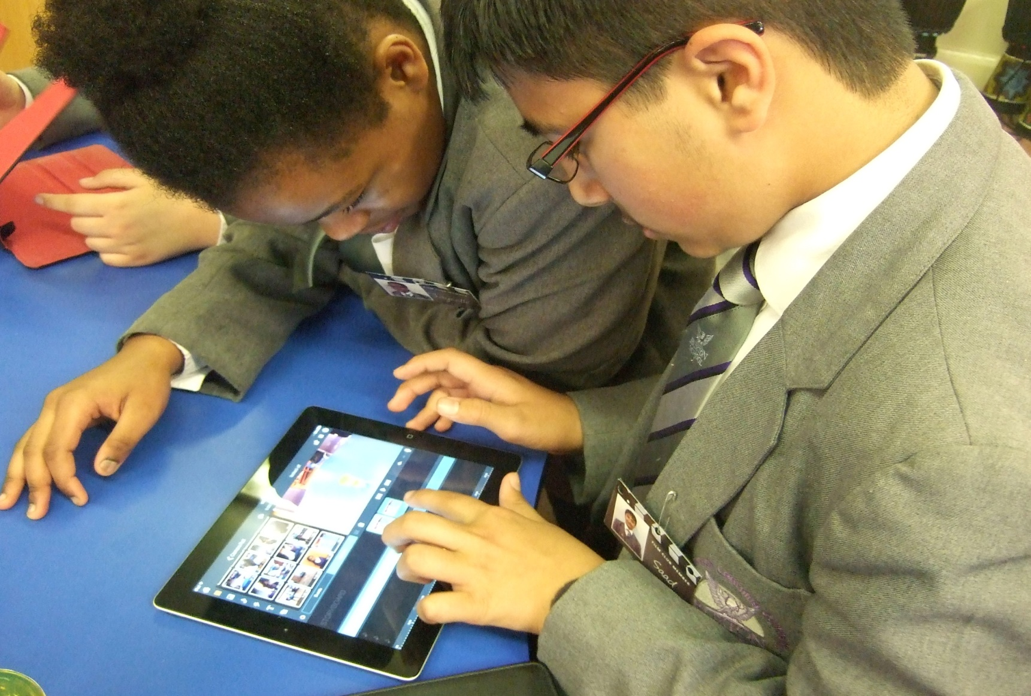
What works
Agency and media in the “third space”
Notes:
More about HOW we teach than WHAT.

Slide 7
What works
First space – home / community
Second space – school / education
Third space – in between
‘In between’:
Physical or metaphorical or digital / virtual
Expertise is exchanged between teacher and student
Learners bring with them repertoires of literacy and funds of knowledge

Slide 8
Evidence of effective practices
Media / school partnerships: eg ‘Entre les lignes’ (Between lines): journalists, photographers and cameramen from Agence France-Presse and the newspaper Le Monde.
Workshops for students, teachers and trainers to develop their critical thinking in the context of online disinformation.
Paradox: Hyman and Jalbert (2017: in the contemporary context, the spread of disinformation does not create intolerant worldviews; rather, intolerant worldviews are what allows disinformation to spread.

Slide 9
Evidence of effective practices
Game-based learning effectively nurtures analytical and reflective ML skills. When students act as producers of games ( Burn et al., 2016), their creative media literacy skills and knowledge can be also developed and improved.
Domingo-Coscollola et al. (2016) DIYLab project) - which supports school leaders in their integration of ‘DIY learning’ across physical and virtual borders. This successful implementation was enabled by a shift in mindset that mingled the roles and identities of teachers and students, and the context of professional development became a hybrid of physical and virtual networking.

Slide 10
Key findings
The field of ML/DL digital literacy is moving away from competence models and protectionist approaches to more robust research that embraces the complexity of ‘dynamic literacies’.
We need to document empirical classroom research to address disconnects between theory and practice; conceptual frameworks and pedagogy; policy and classroom practices.
Successful implementation of media literacy education at the school level is facilitated by approaches to pedagogy that combine and/or cross boundaries between spaces and roles;
There is a wealth of evidence of more formal, funded, partnership engagements between media literacy educators and media industries, literacy organisations, NGOs and other stakeholders at the level of resource production and single events. However, empirical evidence of the conditions for successful partnership and impacts at the school level are likely to be in the public domain within two to three years, as many relevant projects are ongoing.

Slide 11
Policy pointers
Develop dynamic and holistic media literacy curricula
Invest in research into good practices in teaching ML to build resilience to misinformation
Define and adopt a clear connection between M/DL policy, curricula and teacher education
Invest in large-scale collaboration initiatives between media literacy educators, data analysts, social media platforms, journalists and NGOs.
Bring best practices of short-term, small-scale media literacy partnership projects, into the formal school curricula for all students.
Support the inclusion of media literacy competences in the next OECD PISA evaluation criteria.

Slide 12
Media literacy initiatives have been shown to lessen the vulnerability of children to disinformation. However, there is an ongoing debate on the best strategy to address students’ susceptibility to disinformation, revolving around the extent to which interventions should target a person’s core belief system and worldview. Dynamic ML in the third space addresses this tension.
‘Dynamic’ as an antonym of ‘static’ is a signal of a political and ideological opposition to curriculum designs which position students in a narrow and performative experience which is divorced from their actual experience of meaning-making as situated and alive. (Cannon, Potter and Burn, 2018: 181)
Our challenge is to adapt our educational practices to free agentive, social and connected learners from our static systems. A static curriculum puts some young people at risk. Agentive people are less vulnerable.
McDougall, J., Zezulkova, M., van Driel, B., Sternadel, D. (2018). ‘Teaching media literacy in Europe: evidence of effective school practices in primary and secondary education’, NESET II report. Luxembourg: Publications Office of the European Union. doi: 10.2766/613204.

Slide 13
Thank You

