Slide 1
Civics for common values George Psacharopoulos
NESET II and EENEE Conference
Brussels, 22 November 2018

Slide 2
What does the evidence tell us?
Common values in Europe are very weak;
One reason is the way civics are taught in the curriculum;
Pity, because civics is associated with a host of socioeconomic benefits beyond common values.

Slide 3
Active citizens (% of population 16+)
Source: Eurostat

Slide 4
Voters as % of the adult population

Slide 5
Volunteers as % of the adult population
Source: Eurostat

Slide 6
Students’ civics knowledge indicator
“What is the best way to choose a leader
by vote, or
because someone offers to be a leader?”
Only 59% answered correctly!
Source: IEA

Slide 7
Students’ civics knowledge

Slide 8
Students’ civics knowledge
Denmark: 580 score points
Bulgaria: 485 score points
Source: IEA

Slide 9
Students’ civic attitudes
50% trust civic institutions
65% will vote in European elections
Source: IEA

Slide 10
Students’ sense of belonging (index)
Source: OECD

Slide 11
The many benefits of civic behaviour
Political engagement, voting
Respect of the law, less criminality
Better institutions
Environmental awareness
Trusting, delegation
Volunteerism
Social entrepreneurship, NGOs
Productivity

Slide 12
Trust – A major measurable indicator
Because trust reduces transaction costs;
Promotes delegation;
Reduces need for monitoring and policing.

Slide 13
Trust Indicator
Answer to survey question:
“Would you say that most people can be trusted, or that you need to be very careful in dealing with people?”

Slide 14
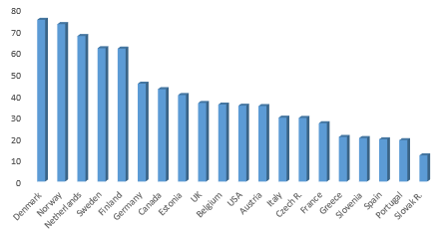
Trusting others (% of the adult population)
OECD average 34%
Source: OECD

Slide 15
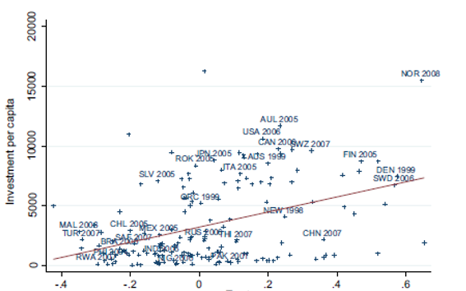
Trust and investment
Trust index
Source: Zak and Knack (2001)

Slide 16
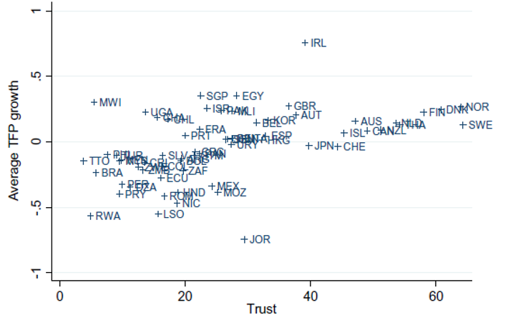
Trust and productivity growth
Source: Bjørnskov and Méon

Slide 17
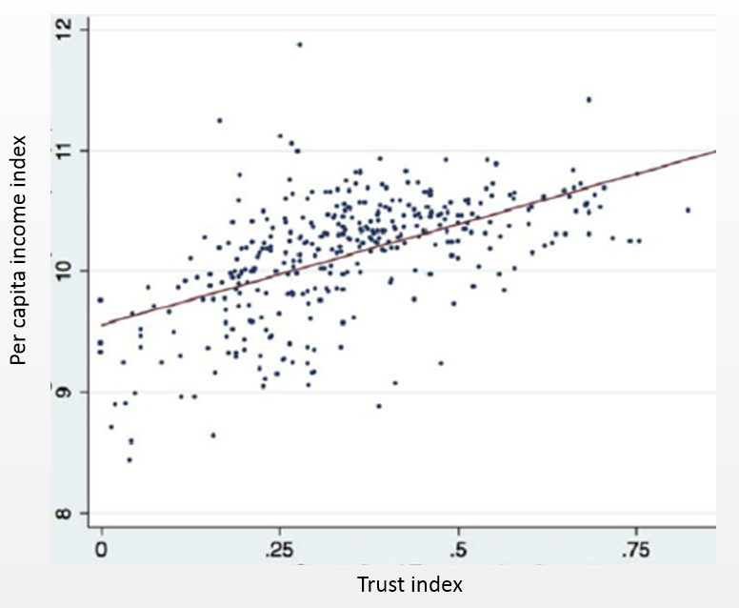
Trust and per capita income, EU-27 regions
Source: Algan and Cahuc (2014).

Slide 18
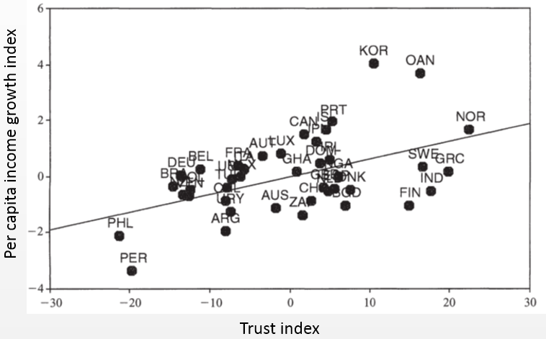
Trust and economic growth
Source: Zak and Knack (2001)

Slide 19
Enormous variation in civics education delivery
Civics-specific
Diffused into other subjects
12 years in France
2 years in Bulgaria
Source: Eurydice

Slide 20
Civics intensity in the curriculum
Country | Hours civics taught
Estonia | 70 hours in grade 9
Ireland | 70 hours over 3 years in secondary
Italy | 33 hours/year in all grades
Norway | 256 hours in grades 8 to 10
Poland | 3 hours/week over 3 years
Russian Fed. | 140 hours in grades 10 and 11
Slovak Rep | 4 hours per week in grades 5 and 9
Slovenia | 1 hour/week in grades 7 and 8
Greece | 1 hour/week in primary
Cyprus | 4 hours/week in primary
Source: IEA

Slide 21
Civic behaviour is not built only by a civics curriculum
The family plays an important role, as well as the general school curriculum.

Slide 22
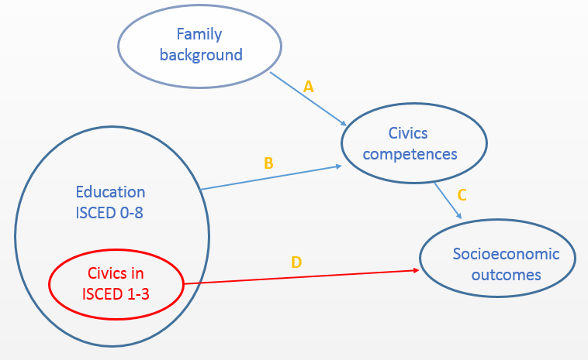
From general and civics education to outcomes

Slide 23
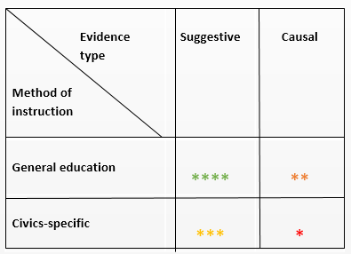
Availability of empirical evidence
Number of stars indicates the quantity of evidence. Green to red colour indicates the quality of evidence, high to low, respectively.

Slide 24
The parental influence
Parental background | Civic knowledge score
Educational level - Below tertiary - Above tertiary | 503 545
Occupation - Below average SES - Above average SES | 501 536
Immigrant - Yes - No | 479 523
Source: IEA

Slide 25
Civic behaviour by level of education
Indicator | Educational level
 | Below upper secondary | Upper secondary | Tertiary
Volunteer | 12 | 18 | 22
Trusts others | 13 | 18 | 29
Has say in government | 23 | 30 | 43
Participates in elections | 74 | 79 | 87
Source: OECD. Average % for adults.

Slide 26
Active citizenship and education (%)
Source: Eurostat

Slide 27
Volunteers and education (%)
Source: OECD

Slide 28
How to instill common values?
Consider its three main determinants:
Socioeconomic background;
In school, by a civics-specific subject in the curriculum;
In school, by tacitly absorbing values from subjects in the general curriculum.

Slide 29
How to instill common values?
Socioeconomic background | Not subject to policy manipulation
2. In school, by a civics-specific subject in the curriculum | Perhaps, but we have no evidence
3. In school, by tacitly absorbing values from subjects in the general curriculum | Lots of evidence

Slide 30
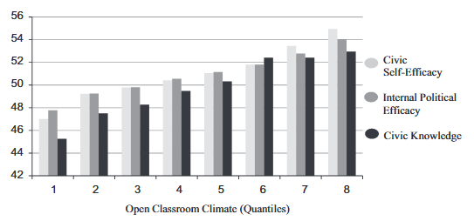
Open classroom and civics
Source: R.T Knowles, J. McCafferty-Wright, The Journal od Social Studies Research, 39 (2015).

Slide 31
To conclude
Fixing problems in the general education system, e.g., improving its quality and reducing early school leaving, would induce civic behaviour and promote common values.

Slide 32
Thank you!
Background: “Education for a Better Citizen: An Assessment”, EENEE AR35 2018.

