Slide 1
Welcome by EENEE – the European Expert Network on Economics of Education Ludger Woessmann (ifo Munich)
NESET II and EENEE Conference
Brussels, 22 November 2018

Slide 2
European Expert Network on Economics of Education
EENEE aims to contribute to the improvement of education policy development in Europe by advising and supporting the European Commission in the analysis of economic aspects of educational policies and reforms
20 Senior Experts from across Europe
Administrative Coordinator:
Centre for European Policy Studies (CEPS), Brussels
Jobs & Skills Unit (Miroslav Beblavý)
Scientific Coordinator:
ifo Institute at the University of Munich
ifo Center for the Economics of Education (Ludger Woessmann)

Slide 3
Topics of EENEE Analytical Reports in 2018
Benefits of Early Childhood Education and Care and the Conditions for Obtaining Them
AR 32 by Michel Vandenbroeck, Karolien Lenaerts and Miroslav Beblavý
Class Size and Student Outcomes in Europe
AR 33 by Edwin Leuven and Hessel Oosterbeek
Education Externalities – What They Are and What We Know
AR 34 by Daniel Münich and George Psacharopoulos

Slide 4
Topics of EENEE Analytical Reports in 2018
Education for a Better Citizen: An Assessment
AR 35 by George Psacharopoulos
Benefits and Costs of Transnational Collaborative Partnerships in Higher Education
AR 36 by Daniela Craciun and Kata Orosz

Slide 5
Topics of EENEE Analytical Reports (under Review)
Effects of Vocational and General Education for Labor-Market Outcomes over the Life-Cycle
By Ludger Woessmann
Education Outcomes Enhanced by the Use of Digital Technology: Reimagining the School Learning Ecology
By Mark Brown, Gráinne Conole and Miroslav Beblavý

Slide 6
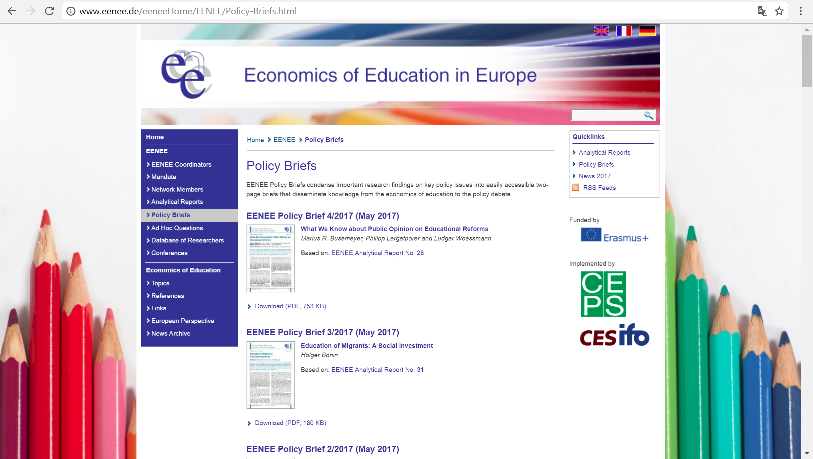
EENEE Website: www.eenee.org

