Slide 1
The role and place of ECEC in integrated working: benefitting vulnerable groups such as Roma dr. Hester Hulpia (VBJK) and dr. Jana Huttova
NESET II and EENEE Conference
Brussels, 22 November 2018
Notes:
Good afternoon
In this presentation, jana and I will guide you to the most importnat results of the NESET II report on Role and place of ECEC in integrated working, which has an added value for all children and families; but with a specific focus on vulnerable groups, such as Roma.
In this presentation I will focus on integrated working in general; my colleague Jana will focus on integrated working in order to benefit the precarious living conditions of Roma,
TEKSTJE BEZORGD AAN DISCUSSANTEN
Role and place of ECEC in integrated working, benefitting vulnerable groups, such as Roma.
Integration of services has become a hot issue, also on the EU agenda (e.g. Recommendations on investing in children, EQF, pillar of social rights). It is seen as the answer to the complex needs of families today. Especially for those living in vulnerable conditions, fragmentation of services is not the right answer. One service alone can no longer deal with the multifaceted problems that vulnerable families face. Integration of services has become the road we need to take. As ECEC is a basic provision for all families, ECEC is a crucial partner in this integrated working.
This session will address the added value that integrated working has for all families, but especially for vulnerable families (e.g. higher accessibility, holistic perspective), professionals (e.g. sharing expertise), and policies (e.g. efficiency). But, there are also challenges. Working together in an integrated way is not self-evident, and certain preconditions should be met. We elaborate on the preconditions at 4 levels: (1) shared vision and goals; (2) leadership, management and competent workforce; (3) policy framework and sufficient funding; (4) participation of families.
The second part of the presentation will focus on Roma, as one of the most disadvantaged and vulnerable groups in Europe. Extreme poverty, unequal access to ECEC, discrimination and segregation that many Roma children experience put them in risk from a very young age, even before they are born. Addressing their complex and specific needs requires comprehensive, integrated and multi-sectoral approach. A model of comprehensive early years intervention model for Roma children and their families that is based on integrated working will be presented. References to examples of good practice will be used to show how integrated working

Slide 2
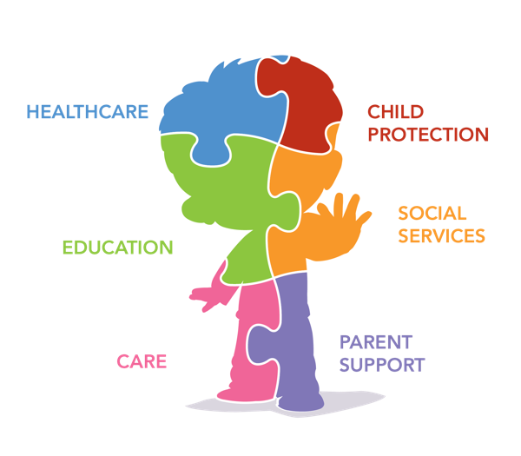
Integrated working is the only way
“Complex manifestations are sometimes referred to as ‘wicked problems’, not in the sense of them being evil in some way, but in the sense of being complex and difficult to solve, and requiring action on multiple fronts and levels.”
Moore and Skinner (2010)
source: INTESYS, 2016
Notes:
Integrated working is the only way to go.
First, because children and families can’t be divided in different pieces, as shown in the figure. Or as katrien Verhegge, head of the Flemish administration said: a problem of a child or a family is never isolated, it is always holistic. So services should work holistic as well

Slide 3
Integrated working is the only way
Practice: family centres (Scandinavian countries), children’s centres (e.g. Pen Green, UK), Huizen van het Kind (Flanders, Belgium).
Research: INCh, ISOTIS (Barnes et al., 2018).
High on the EU agenda (e.g., in EQF and Erasmus+ projects).
Notes:
It is clear that one organisation alone can no longer deal with the multifaceted problems that vulnerable families face. Fragmentation between services should therefore be avoided.
So, we can only conclude that integrated working, where there is a clear collaboration between sevices, is the only way to provide sufficient support for children and families .
The tendency towards more integration is clearly seen in practice, reserach and policy. It is high on the agenda of several member States, as well on the EU agenda
In research integrated working receives a lot of attention: for example in the
INCh research: Integrated Networks to combat Child poverty
ISOTIS research – a Comprehensive review of the literature on inter-agency working with young children, incorporating findings from case studies of good practice in interagency working with young children and their families within Europe.
Also, Integrated working is high on the EU agenda. Think of Recommendations on investing in children, EQF, pillar of social rights.

Slide 4
Defining integrated working
“The cooperation between organisations and/or services to avoid fragmentation, facilitate better alignment of services and increase benefits for service users.”
(Gordon et al., 2016)
Notes:
Integrated working is a hard to define concept.
1, there are many different terms used interchangeably; all referening to a form of collaboration; think of cooperation, collaboration, inter-agency working, comprehensive working, interdisciplinary working, integrated approach, networking, …
2, Integrated working is also very context specific, as it starts from the needs of the children and families. So many different forms of integrated working exist.
But for us the definition of Gordon and colleagues as defined in the INTESYS project is our guiding frame
Integrated working is about the cooperation between organisations and/or services to avoid fragmentation, facilitate better alignment of services and increases benefits for service users.

Slide 5
ECEC and integrated working
ECEC can play a pivotal role:
enriching practices for children and providing support for parents;
accessibility of ECEC <-> partner services; and
Sharing expertise.
Notes:
As high quality ECEC is a universal provision, which has a long lasting positive influence on children, families and society, ECEC is a crucial partner in integrated working.
First, more cooperation with other services can lead to enriching practices for children (think of a collaboration with a library, or an art school). Also for parents it can be enriching and supportive in raising children
Second, ECEC is a crucial partner in integrated working in order to higher accessibility, which is one of the quality aspects in the European Quality Framework.
This plays in 2 directions:
ECEC services can be the bridge to other organisations – if parents ask questions ECEC services can connect parents to for example family support services.
But it also goes in the other direction. Partner organisations can guide families to ECEC services. As ECEC is, in many countries, not equally accessible and often children of minority groups or low income families have a lower enrollement; other organisations can be the bridge to ECEC services
Third, sharing expertise. High quality ECEC has a lot of expertise, think of working child-centered, the holistic view, partnerships with parenrts, working in with diversity, … By working in an integrated manner ECEC services can share this knowledge and ensoule other services.

Slide 6
Added value of Integrated working
 | Added-value
Families and children | Higher accessibility, easier to find what you need; Services better linked to needs and diversity of issues; More community cohesion; Smoother transitions from one service to another; Shared ownership and strengthened partnerships.
Professionals and organisations | Combining strength and capacities in dealing with challenges; Co-learning and professional development; Higher efficiency.
Policy level | Less overlap, gaps and fragmentation; Better use of scarce resources.
ECEC
Notes:
Integrated working is assumed to have many benefits . It is assumed that it has a win on 3 levels
1, a first win for the families
2, a second win for the partner organisations, and the professionals working there
3, a third win at the policy level

Slide 7
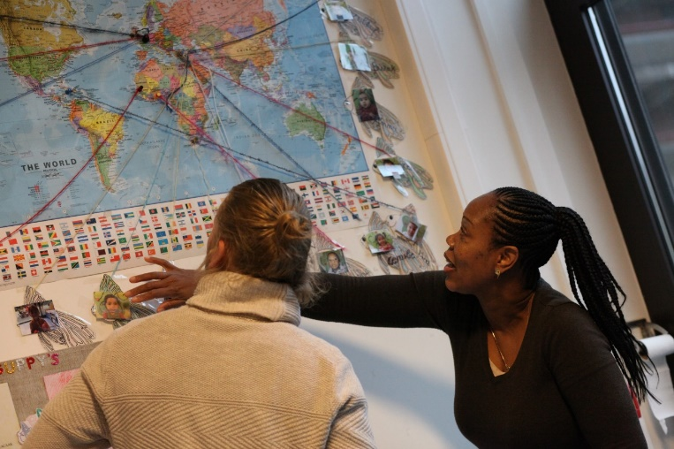
Recommendations for integrated working
Shared vision and goals, starting from the needs of the children and families in the community;
Family involvement;
Competent system with strong leadership and reflective staff;
Policy and funding.
Notes:
Although there is often an ‘integrated eupharia” ; integrated working does not by definition come to the just mentioned benefits.
There should be:
Shared vision and goals starting from the needs of the children and families in the community.
Integrated working is more then just collaboration with others, the needs of the families is at the heart of the integration.
Next to this, it is important that the different partner organisations search for a shared mission : why are we working together? This will bond all partners and keep the fire of integrated warm
2. Family and community involvement
As the children and parents are at the core of the network, they should be involved as well. Child and parental involvement in the broadest sense should be in the DNA of the network,
3, a competent system with strong leadership and reflective staff
Integrated working needs a strong leadership, where the leader focuses on connecting partners
It also demands a reflective workforce, who are willing to learn from and with others
This asks off course a competent system where all partners receive sufficient support (such as training, CPC, child free hours, …)
4. Policy and funding
Finally, a supportive policy that provides sustained funding and gives the organisations time to cooperate, to try new things, time to grow slowly
Only if these 4 prerequisites are in place, then Integrated working can show it’s added value for all children and families, and especially for those in vulnerable living conditions

Slide 8
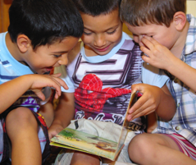
Why integrated working for Roma children?
One of the most vulnerable groups in Europe.
Often with multiple-disadvantages across many interconnected dimensions:
Extreme poverty and difficult living conditions;
Unequal access to ECEC, health, social protection, housing, etc.;
Stigma, discrimination, stereotypes and prejudices.
Multi-dimensional and comprehensive approach to child health, development and well-being can help break the cycle of poverty and exclusion (Bennett, 2012).
Integrated and inter-sectoral strategies combining prevention, early years intervention and support to families are needed (EC, 2018).

Slide 9
How could it work? Integrated working and a comprehensive multidimensional early intervention model
Medical centres, hospitals
Mobile health and dental screening services;
Maternal health care and gynaecological consultations;
Parental consultations.
POLICY CONTEXT
Nurseries/creches, kindergartens, playgroups, libraries and toy libraries
Early cognitive, social and emotional skills development;
Learning environments sensitive to children’ needs, culturally relevant learning;
Parental participation and support for parents.
LOCAL GOVERNMENTS
ECEC settings
Health and social services
Children and parents/carers/ families
Early intervention services
Frontline and outreach services
Community mediators, visiting nurses, Roma teacher assistants
Home visiting;
Parental support and parental engagement - reading stories.
Children‘s centres, community centres, family centres
Speech therapy, language support, early screening, sensory or physical therapy, psychological services;
Parental support and empowerment.

Slide 10
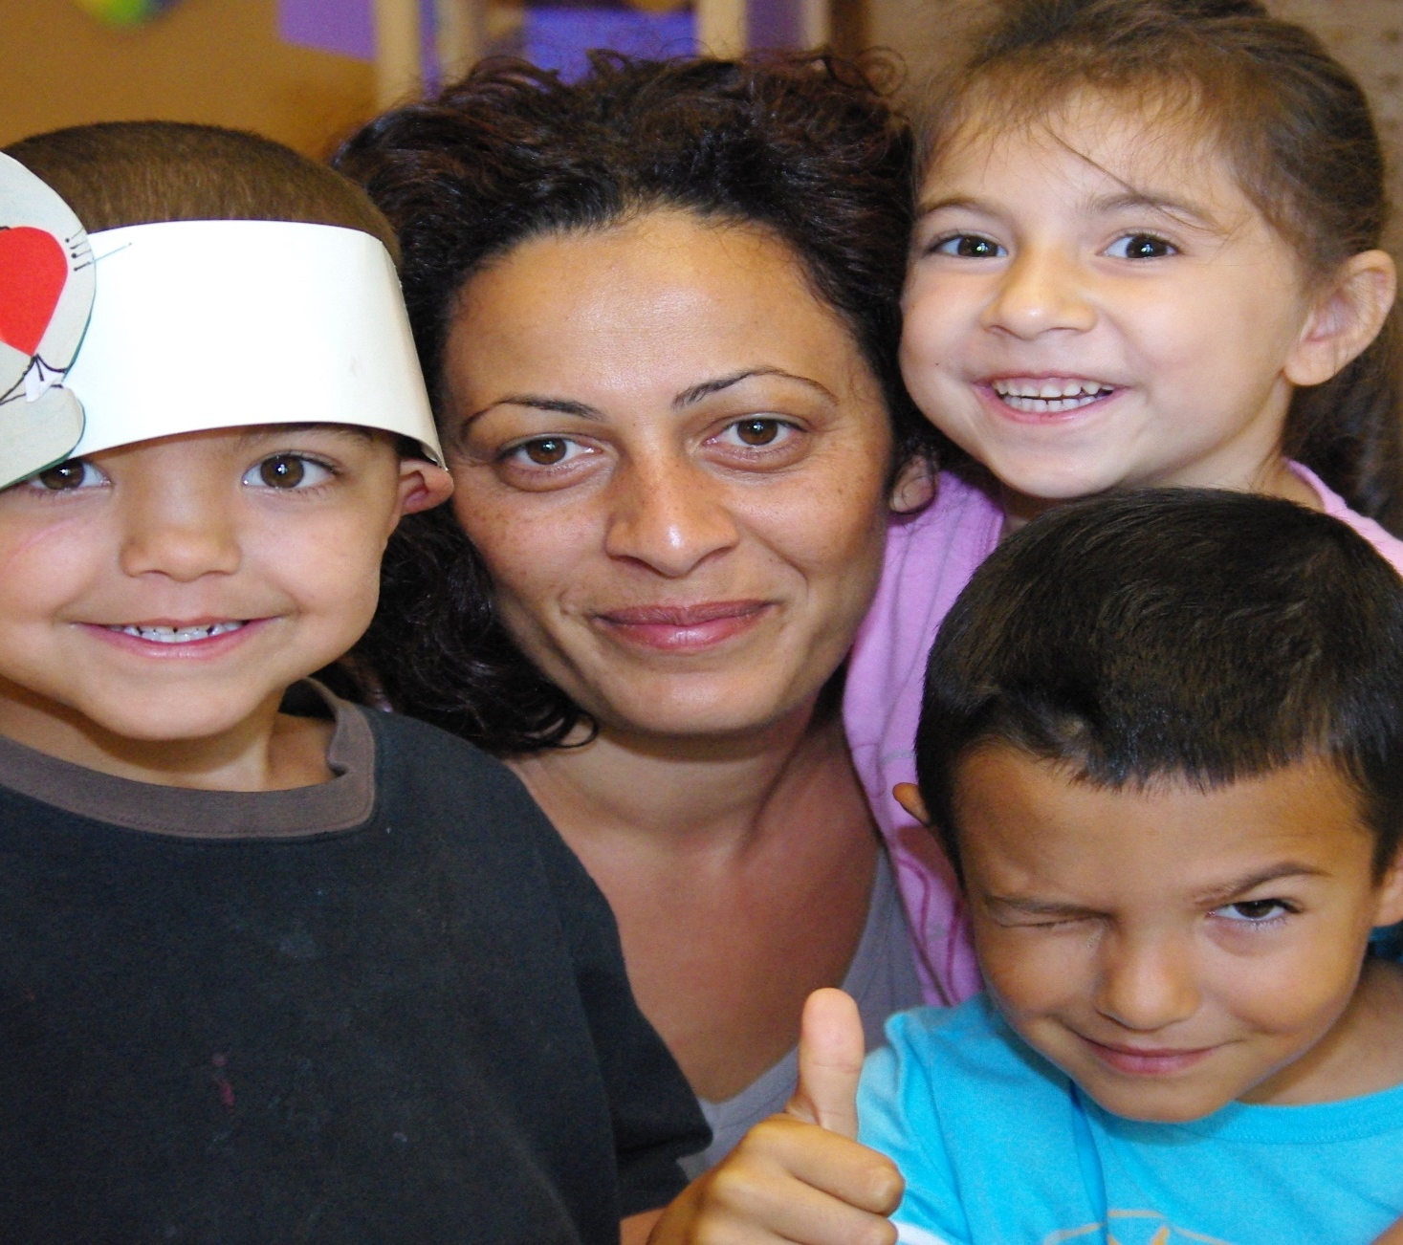
Evidence from good practice examples of integrated working that benefits Roma children.
National level: Sure Start Children’s Houses programme (135 SSCH in most disadvantaged regions/districts, Hungary, our case - Porcsalma).
Regional/municipal level: Tundza municipality (Bulgaria).
Project level: “Ready Set Go!” project (11 localities in 6 counties, Romania).
Case study researchers: Szilvia Rézmüves (Hungary), Eugenia Volen (Bulgaria), and Danut Dumitru and Claudiu Ivan (Romania)

Slide 11
How does it work? Example: Sure Start Children’s House, Porcsalma, HU
For whom? | Main partners | Key components | Some of the main factors for success
Children (0-3) and their parents in the most disadvantaged regions/districts; Children receiving child protection benefits . | SSCH, health visitors, kindergarten, Family Care Centre and Community House, local government. | Universal services, such as visiting nurses, with non-formal learning activities for parents (e.g. Story Telling mothers programme), parental support, health counselling, play activities, opportunities to cook and to do their laundry. | - SSCH part of national child protection and welfare legislation, as well as anti-poverty and social inclusion strategies. - Funding from the national budget. - Commitment and active support of local government. - Networks and partnerships, informal daily contacts. - Roma participation (Roma social worker, Roma assistant). - National regulations for quality of services.

Slide 12
Contact Hester.Hulpia@VBJK.be jhuttova@gmail.com
NESET II and EENEE Conference
Brussels, 22 November 2018

